Slide 1

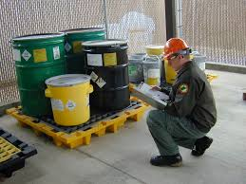




FC-GL-EHS-ENV-0903: Environmental Management Waste and Stormwater
Key Points
Replaces and supersedes - FC-GL-EHS-ENV-0903: Waste Management Applicability chart to identify different requirements for customer sites and fixed facilities Requirement to follow waste hierarchy where possible
FieldCore Fixed Facilities
Document Environmental Management activities using procedural forms
Key Tools
FC-GL-EHS-ENV-0903-F1: Waste Inventory – Fixed Facilities FC-GL-EHS-ENV-0903-F2: Waste Disposal Log FC-GL-EHS-ENV-0903-F3: Weekly Waste Inspection Checklist FC-GL-EHS-ENV-0903-F4: Stormwater Pollution Exposure Inspection FC-GL-EHS-ENV-0903-G1: Waste Risk Assessment
Select ComplyWorks approved waste vendor and assure vendor has signatory authority for hazardous waste manifest chain of custody responsibility
Minimize waste generation where possible
Project / Service sites where FieldCore has contractual responsibility for waste
Customer or Landlord has contractual responsibility for waste
Comply with customer or landlord requirements.
Do not remove waste from site
Further Work / Support
Fixed Facilities compliance calendar task for annual stormwater pollution exposure inspection Full Implementation by: 30 Jan 2024
V3 / Oct 2022

